Slide 1
Concurrency
Saint Petersburg, 2019

Slide 2
Content
1
Hardware basics
2
Software basics
3
Java thread management
4
Concurrency general concept
5
Java concurrency implementation
6
Conclusion

Slide 3
Concurrent computing is a form of computing in which several computations are executed during overlapping time periods—concurrently—instead of sequentially (one completing before the next starts)
Definition

Slide 4
Hardware basics

Slide 5
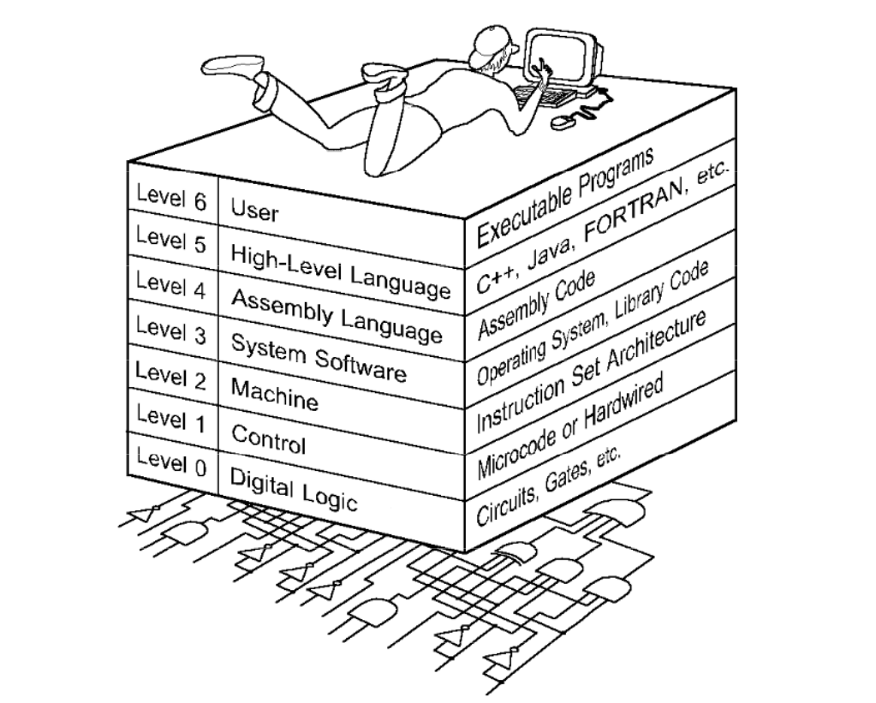
The World we are living in

Slide 6
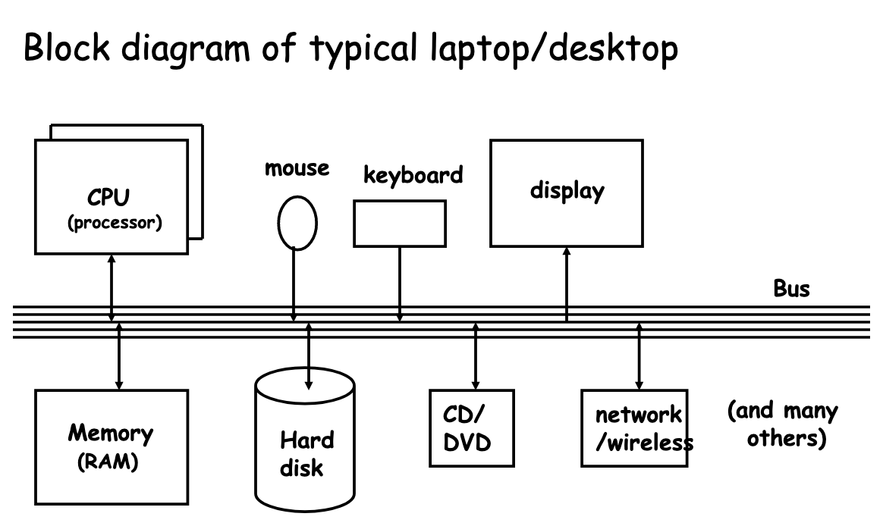
Computer architecture

Slide 7
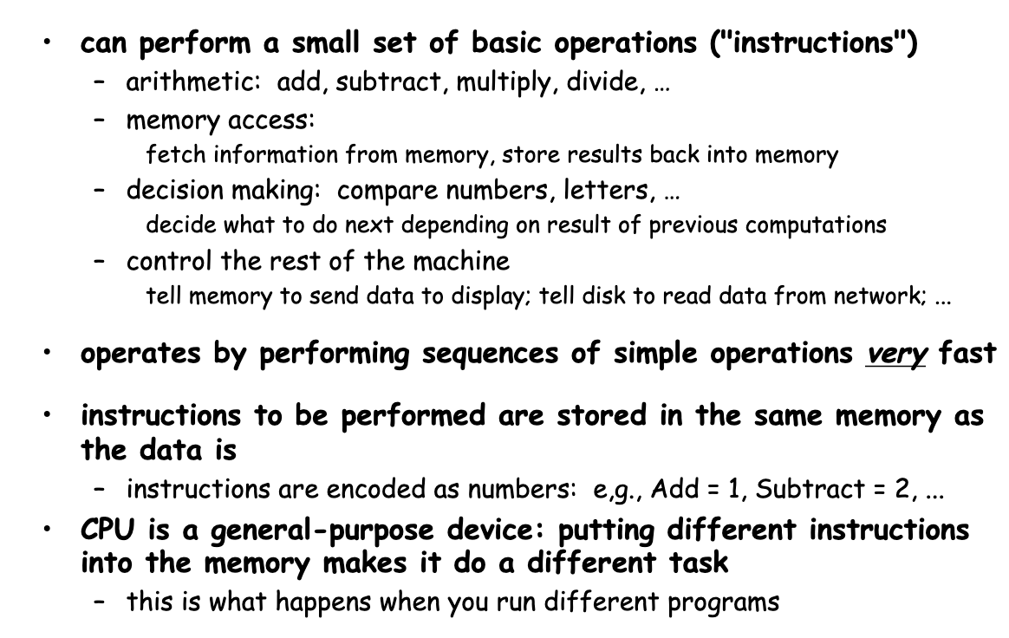
CPU

Slide 8
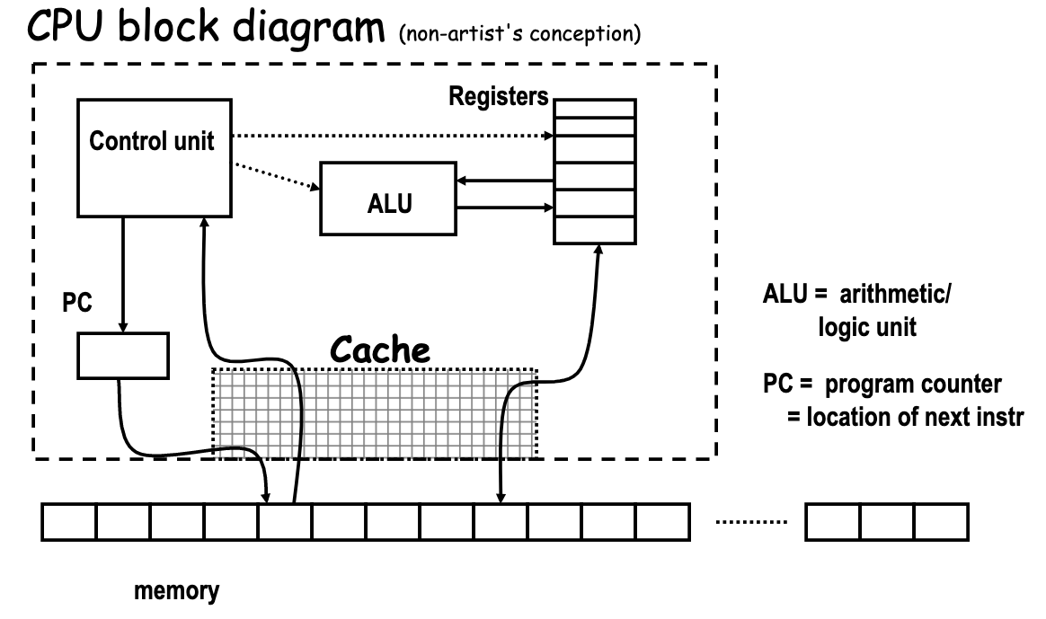
CPU

Slide 9
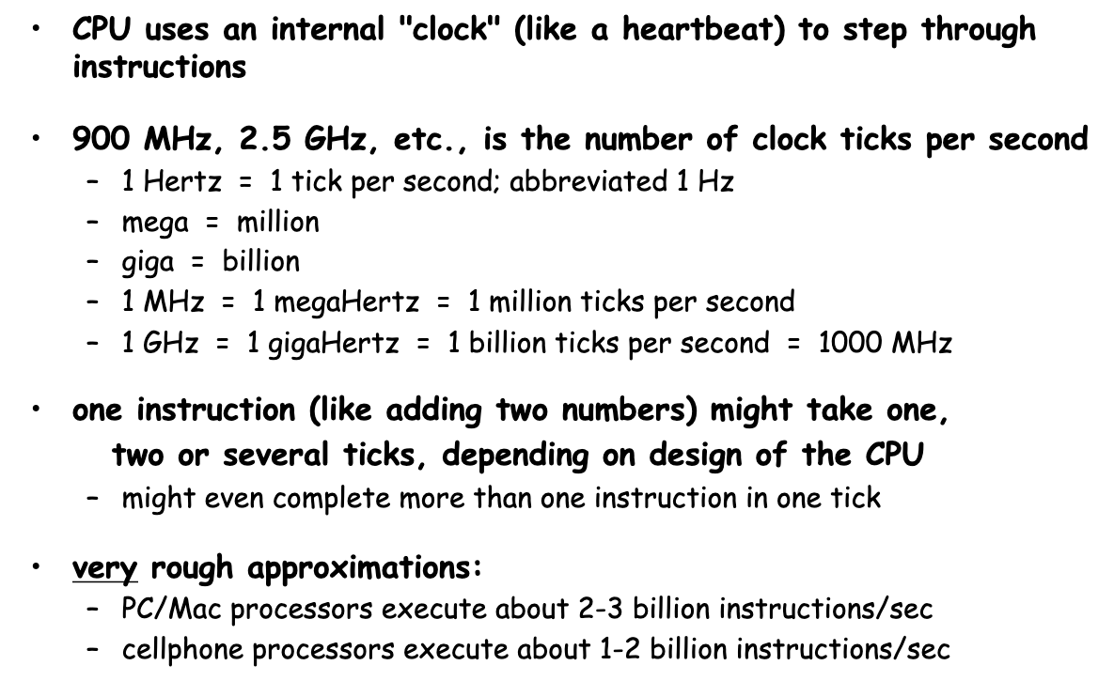
How fast is fast?

Slide 10
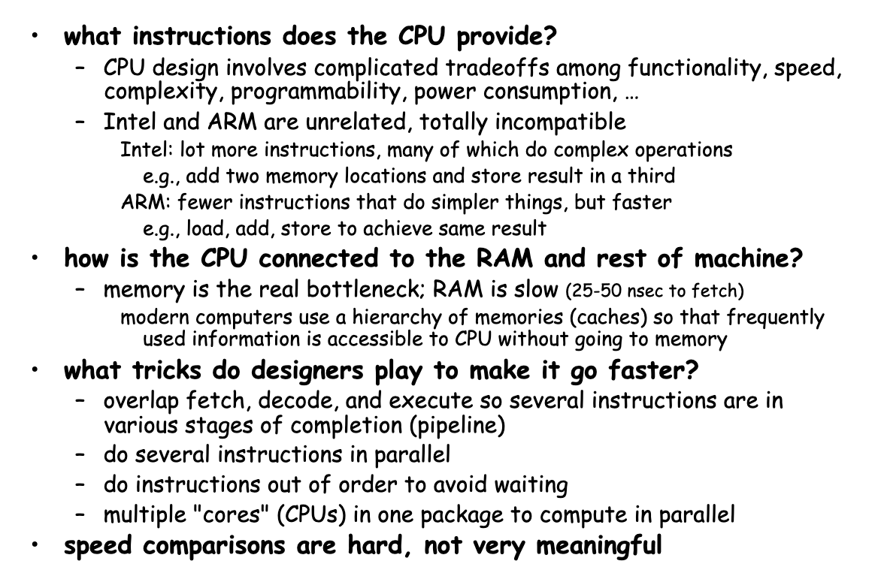
Computer architecture

Slide 11
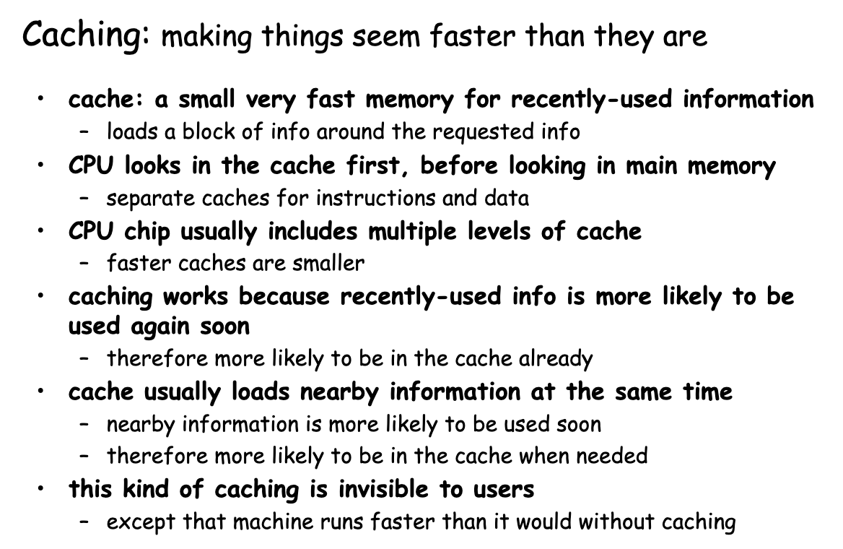
CPU caching

Slide 12
Software basics

Slide 13
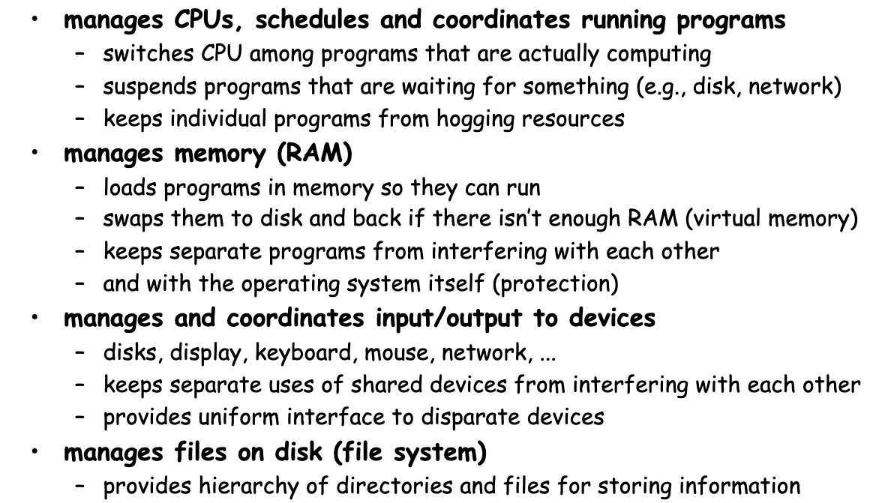
What an operation system does?

Slide 14
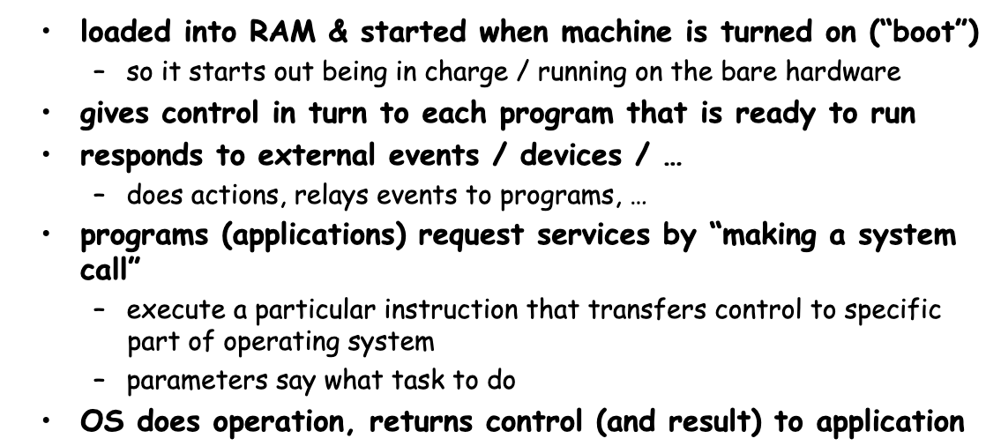
How does an operation system work?

Slide 15
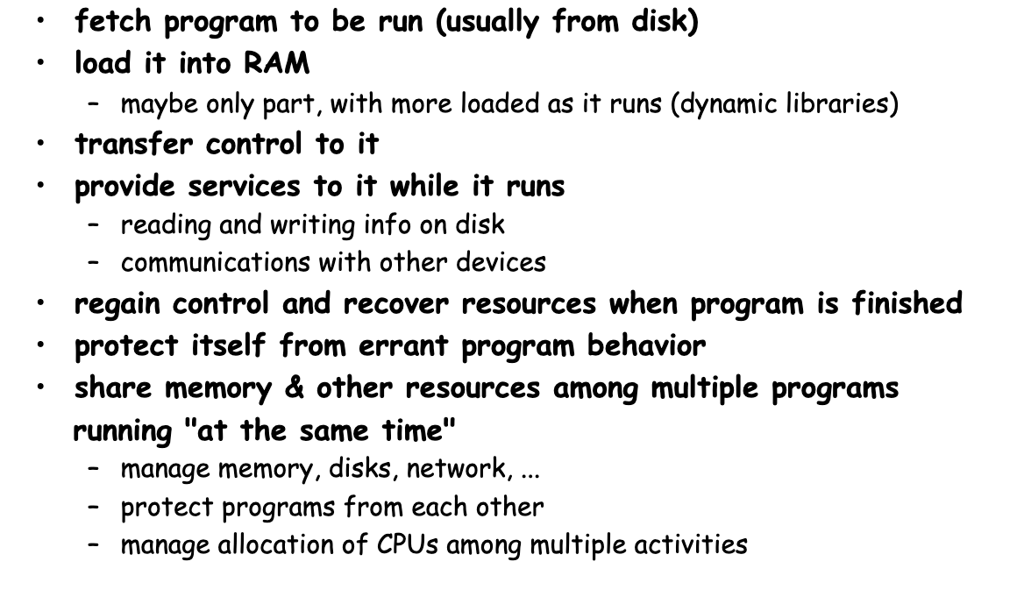
To run programs, the operation system must

Slide 16
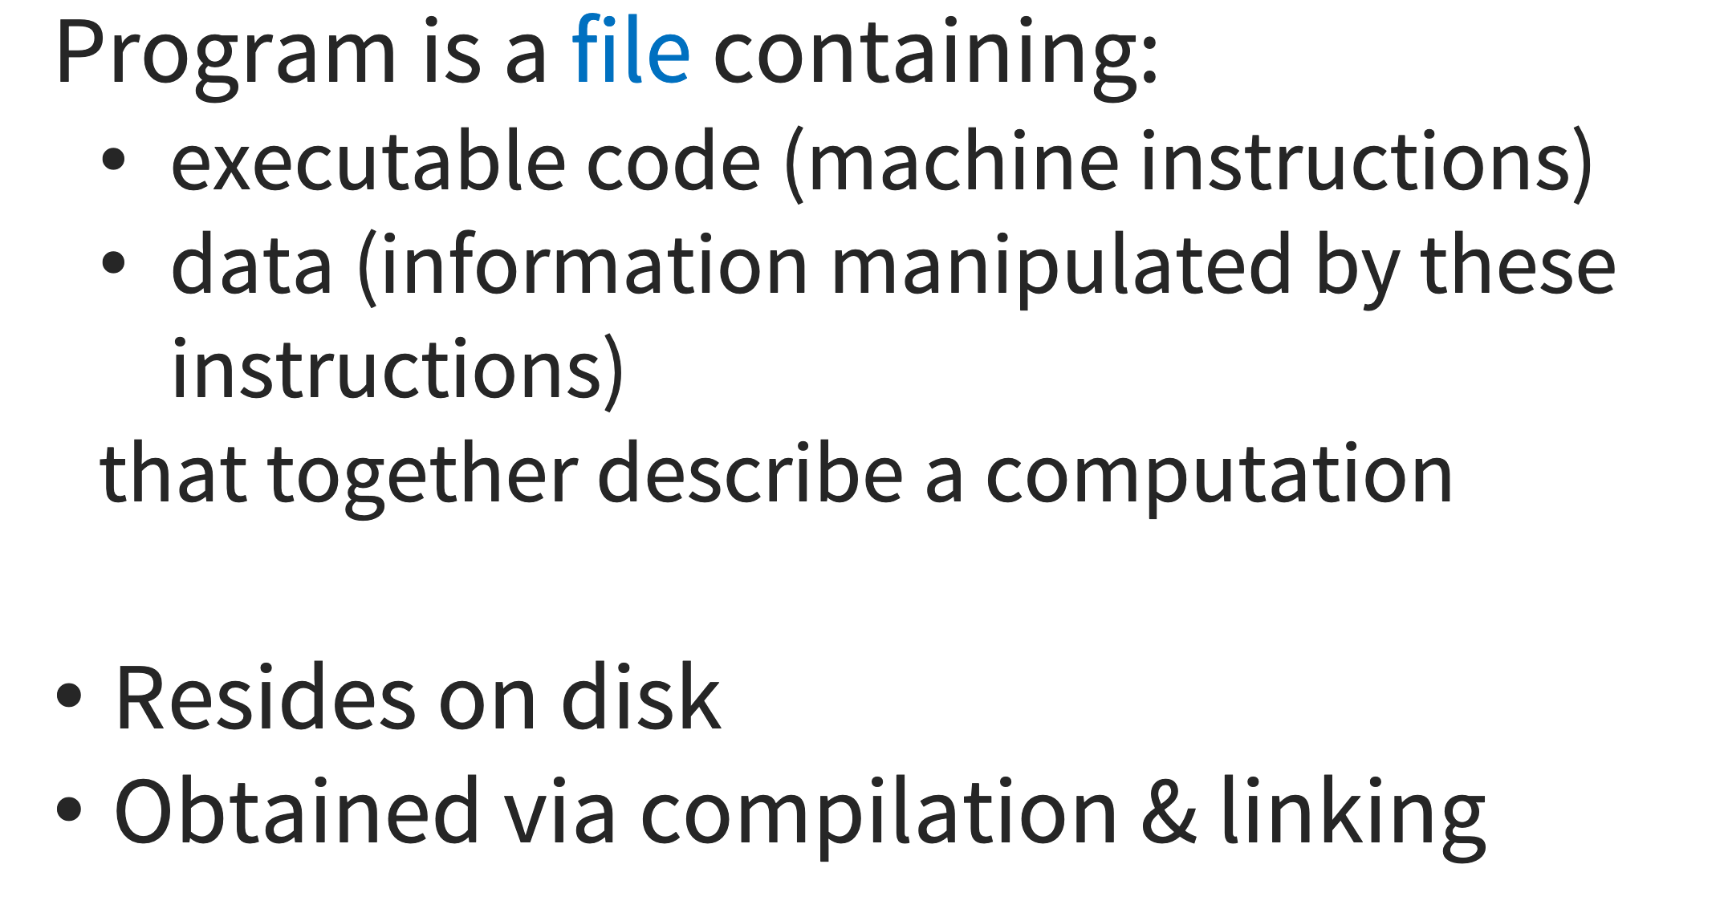
What is a Program?

Slide 17
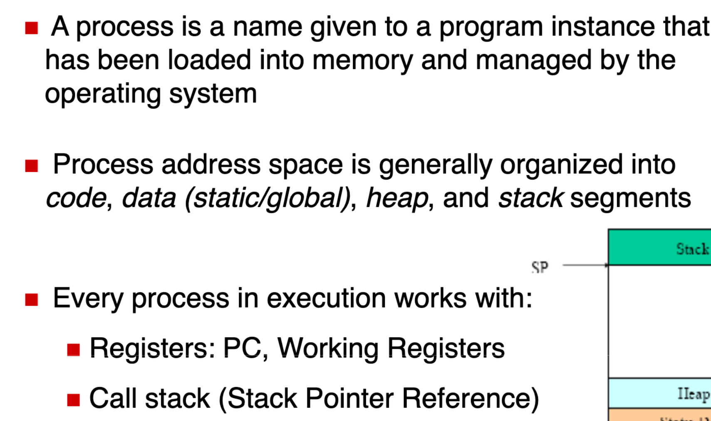
Process

Slide 18
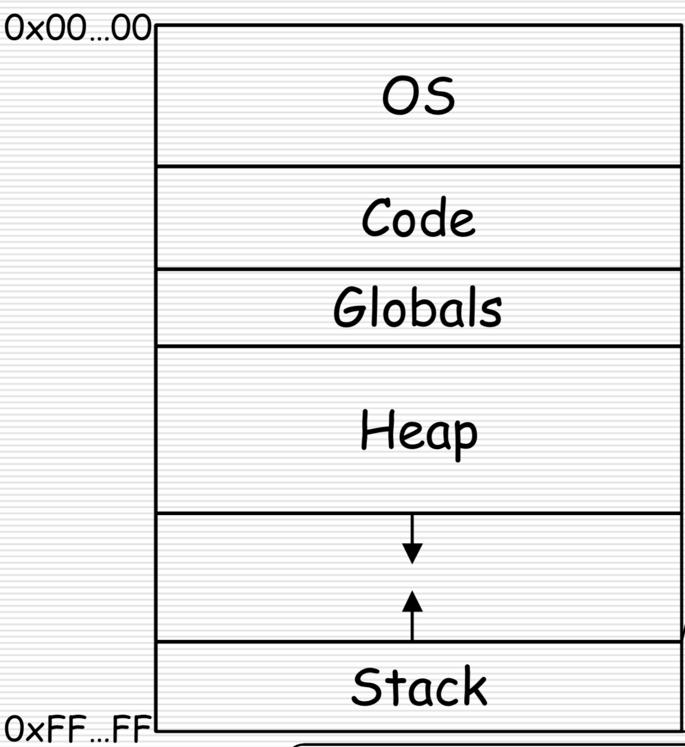
Process

Slide 19
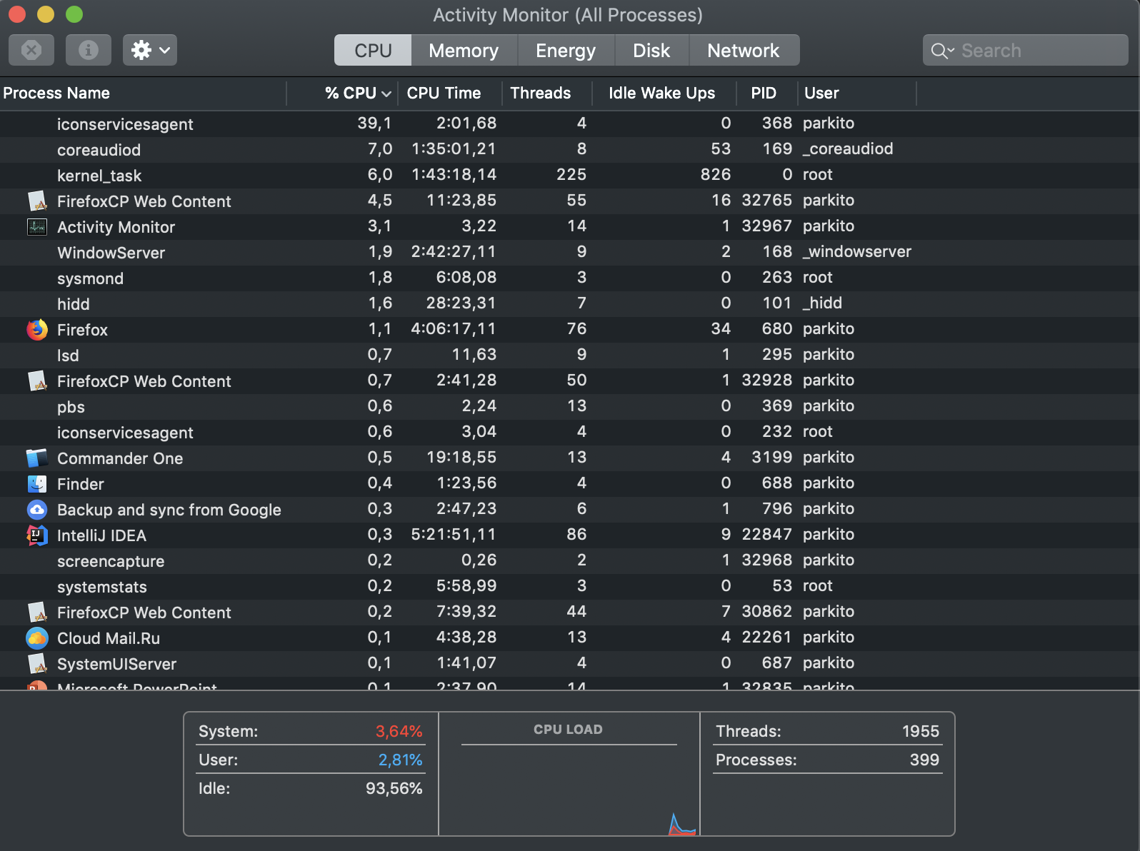
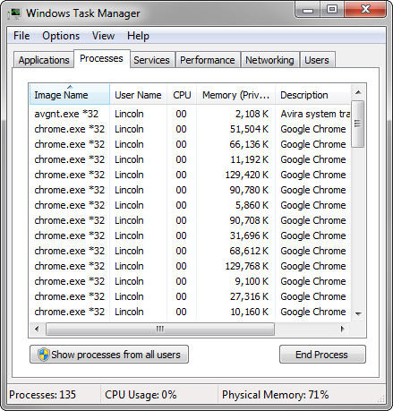
Processes

Slide 20
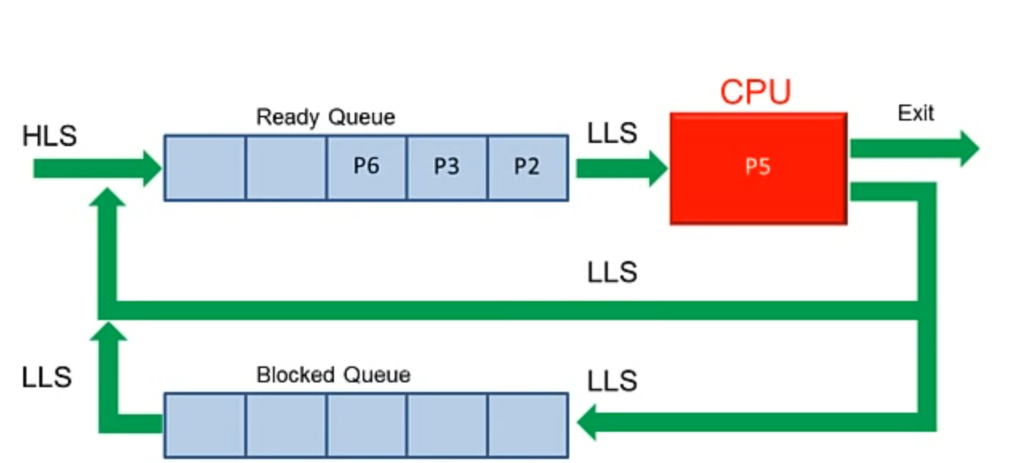
Process scheduler

Slide 21
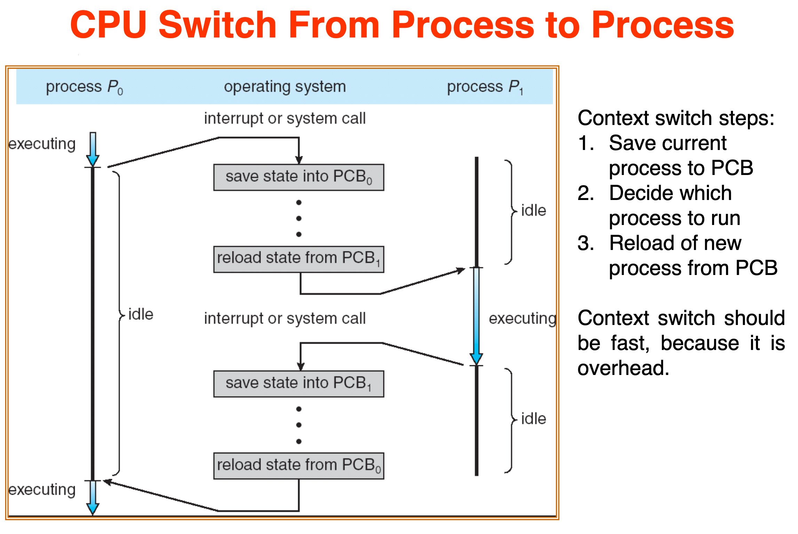
Process scheduler

Slide 22
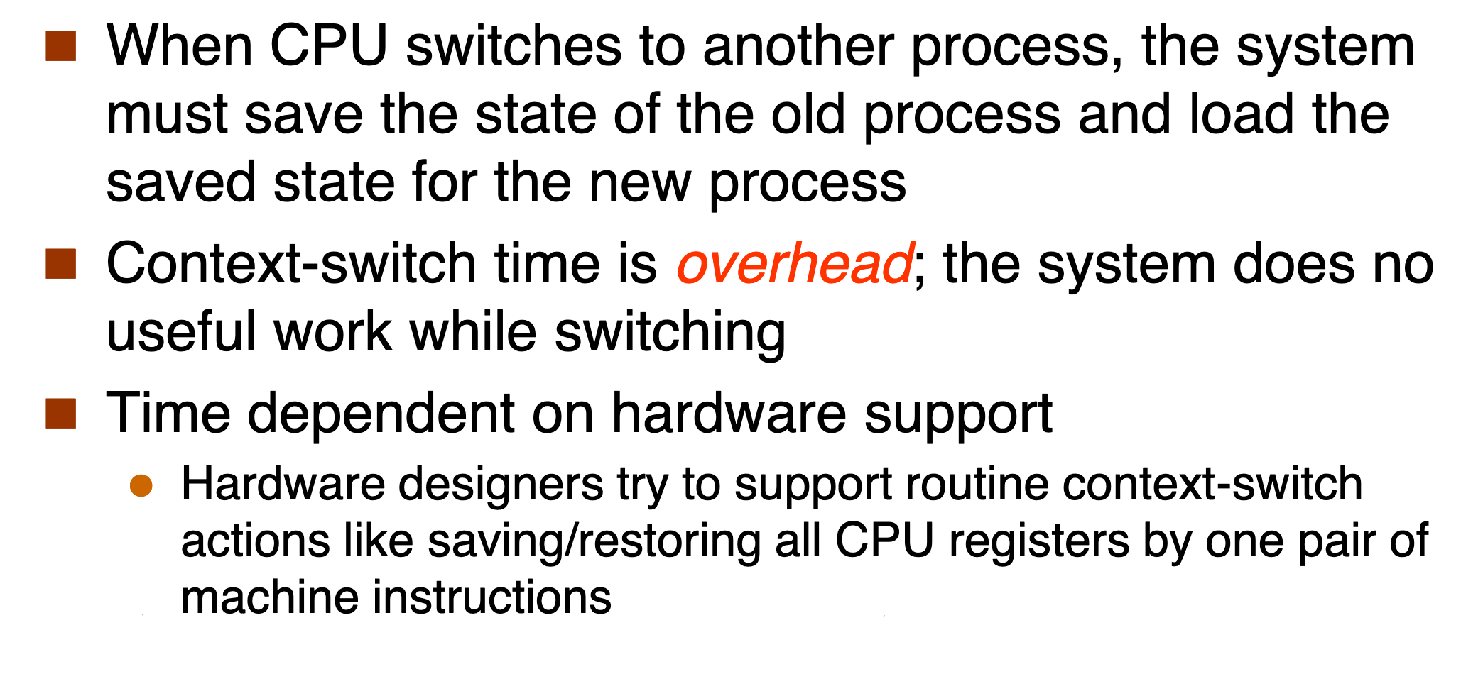
Context switching

Slide 23
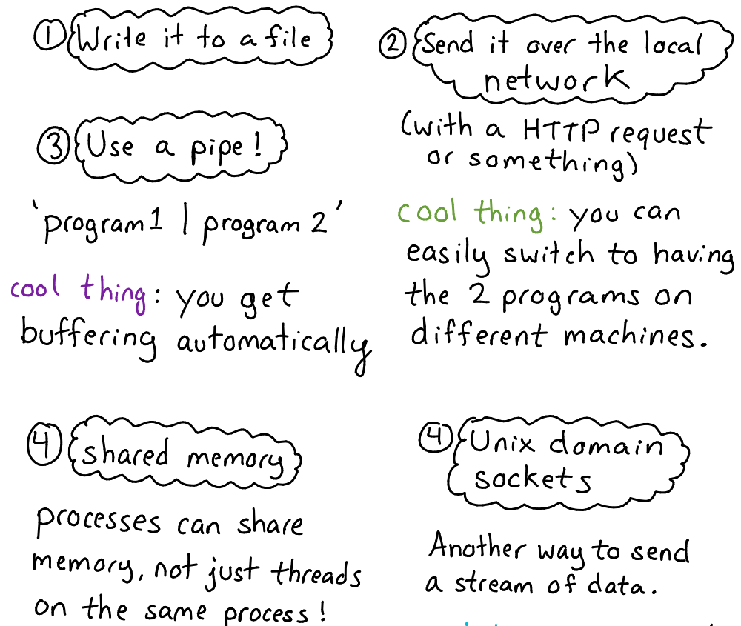
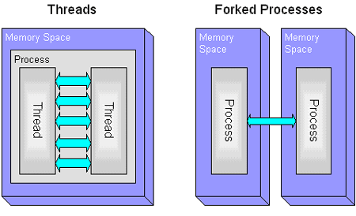
Inter-process communications

Slide 24
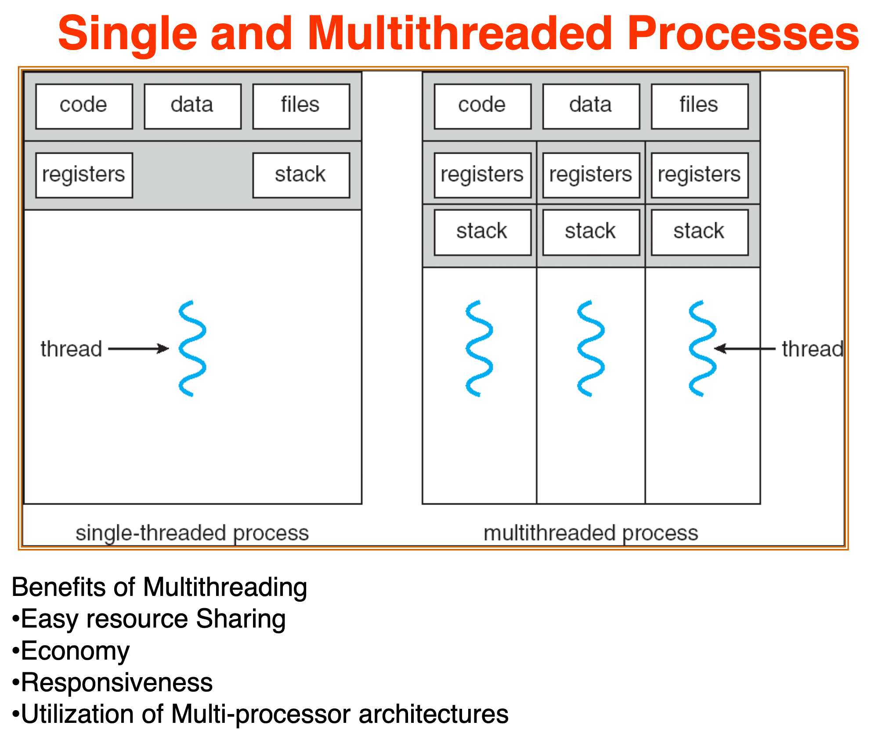
Threads

Slide 25
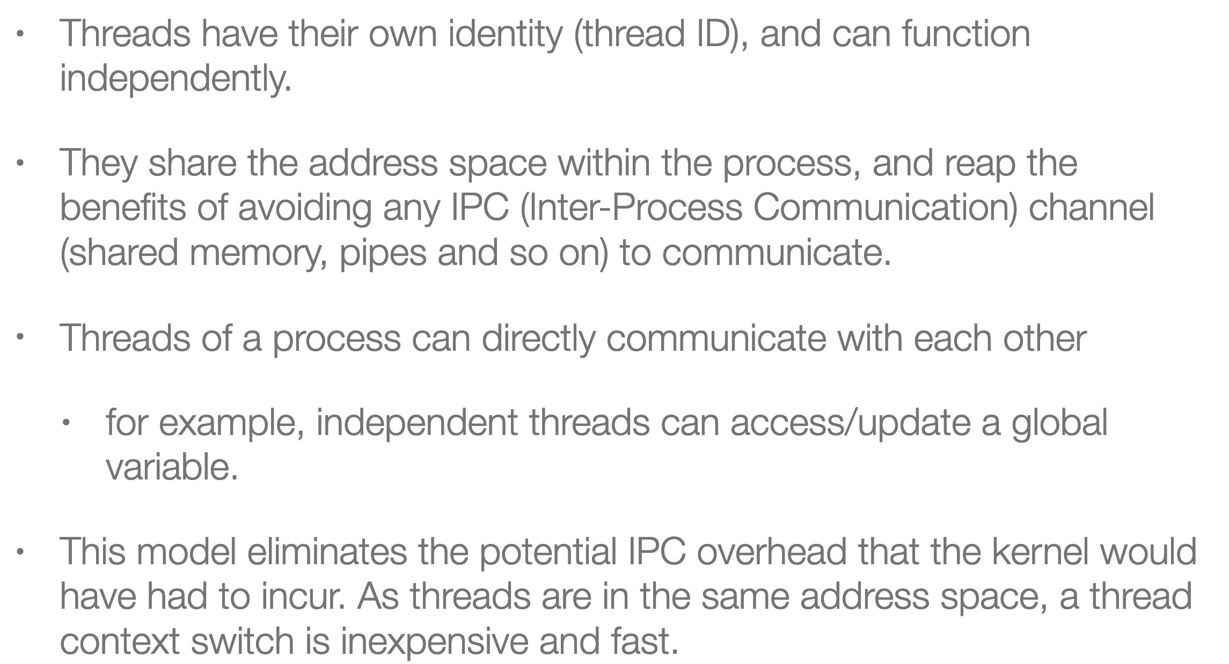
Threads

Slide 26
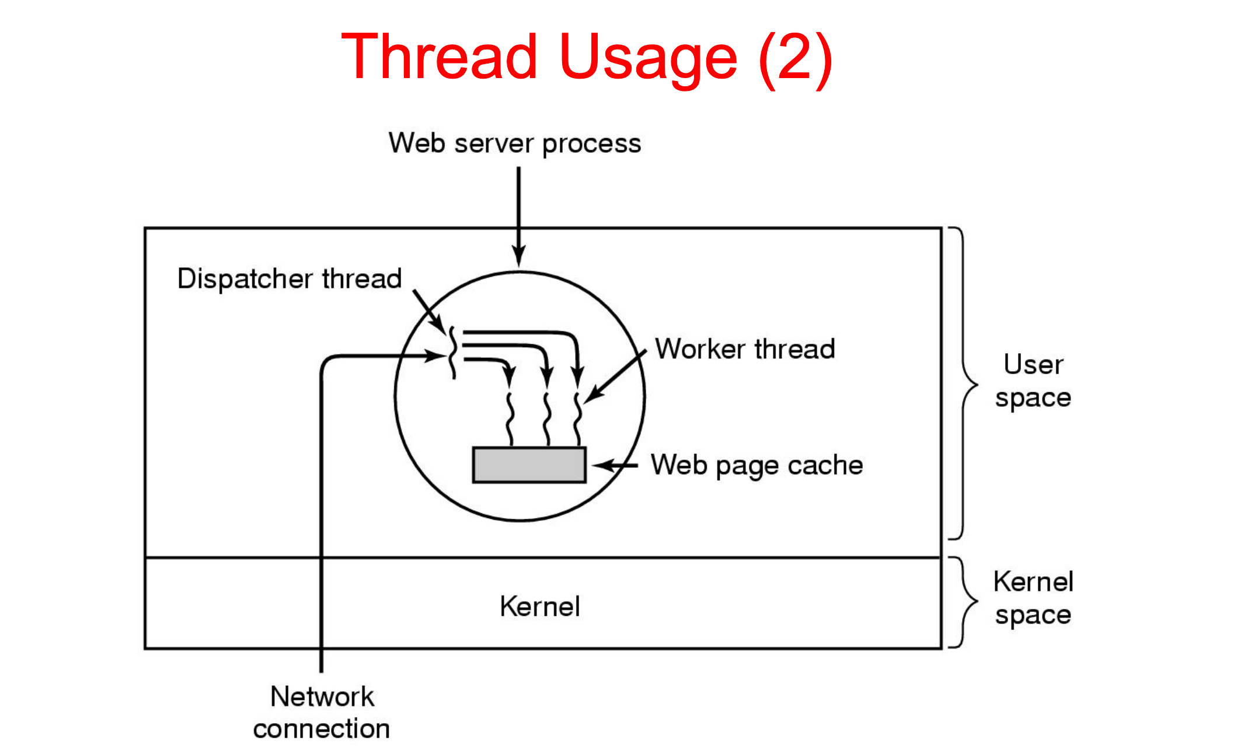
Threads

Slide 27
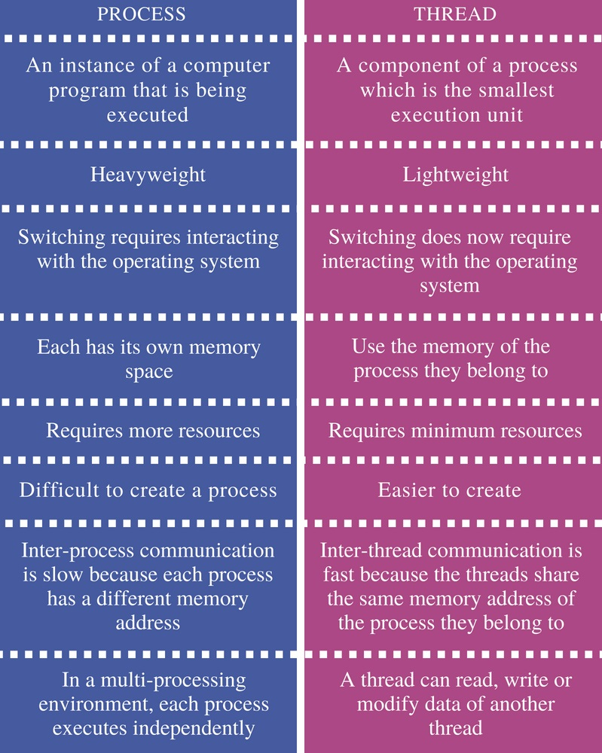
Threads

Slide 28
Java basics

Slide 29
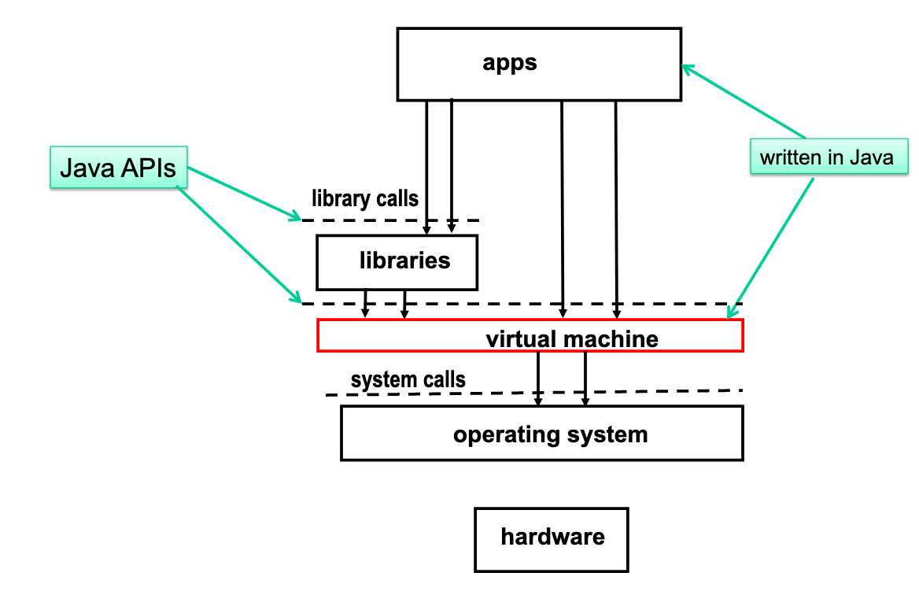
JVM execution architecture

Slide 30
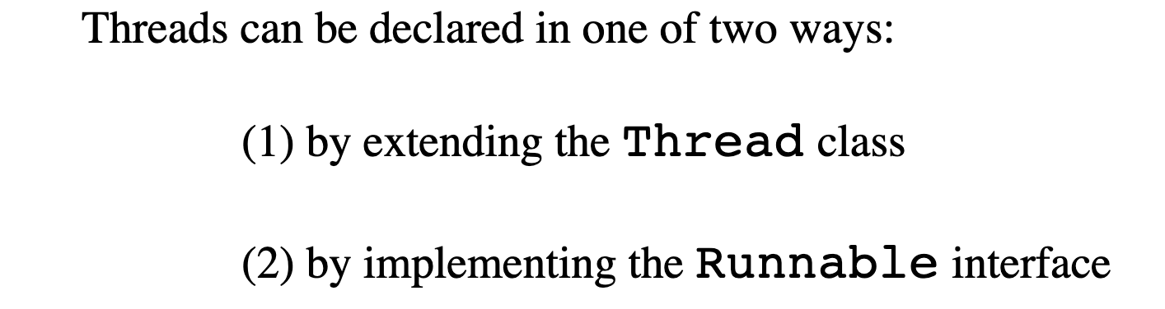
Thread creation

Slide 31
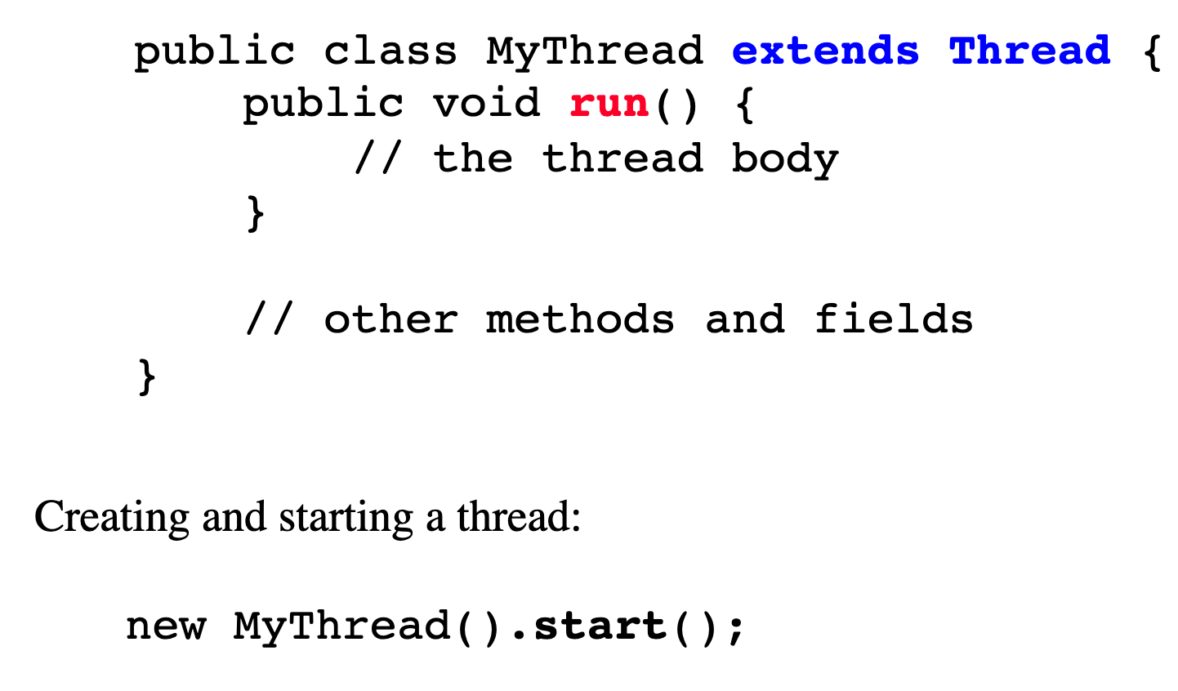
Thread creation

Slide 32
Thread creation

Slide 33
Example 1,2,3

Slide 34
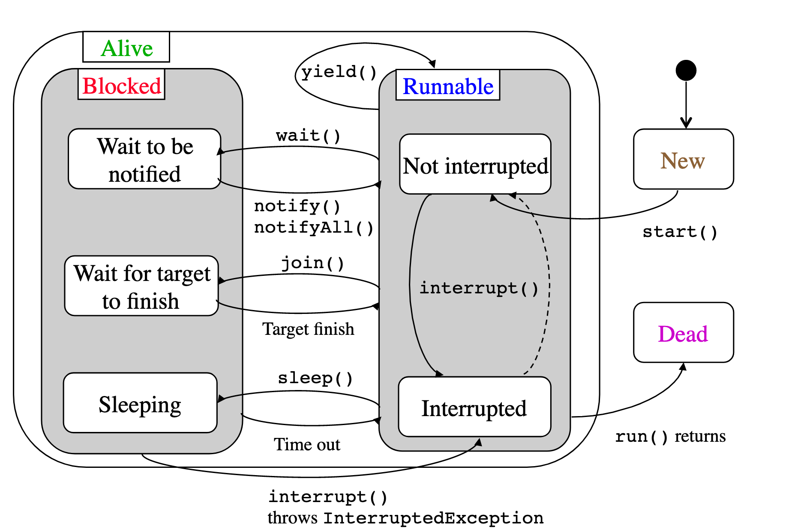
Thread life cycle

Slide 35
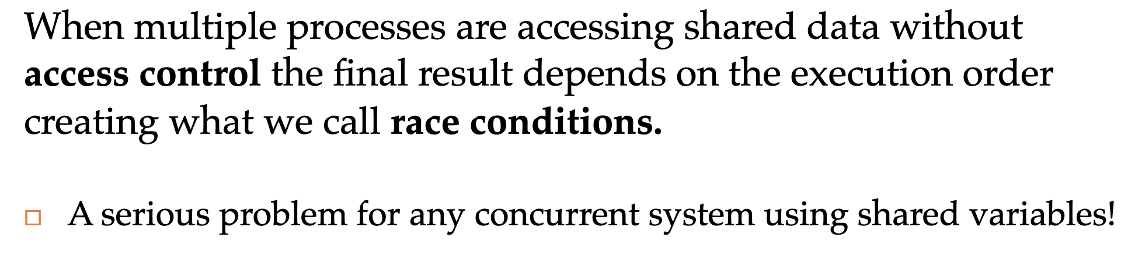
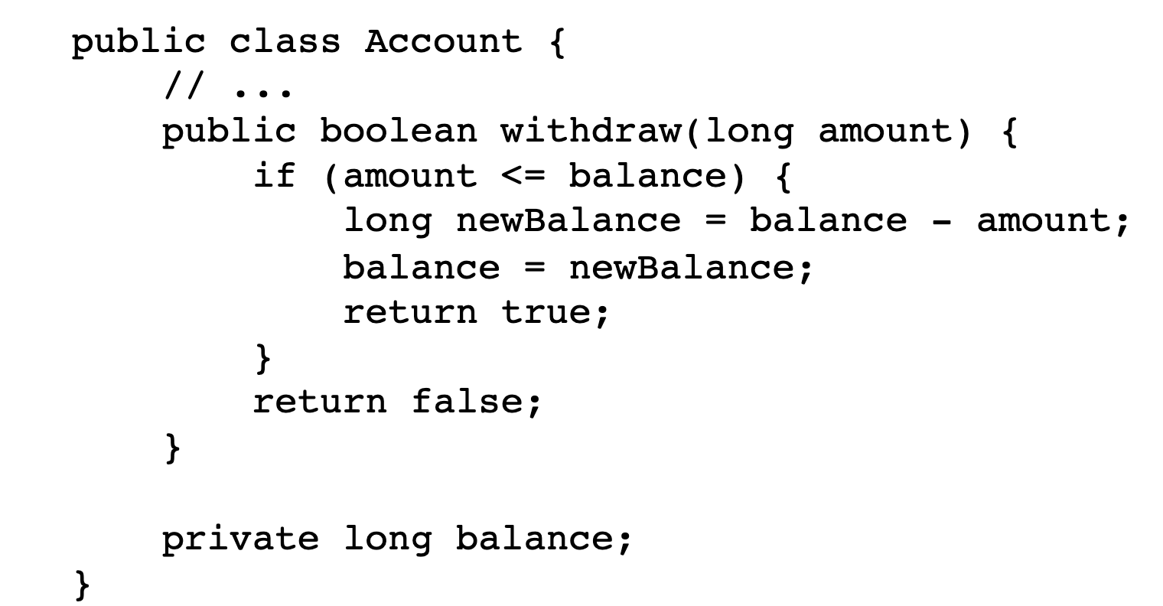
Race condition

Slide 36
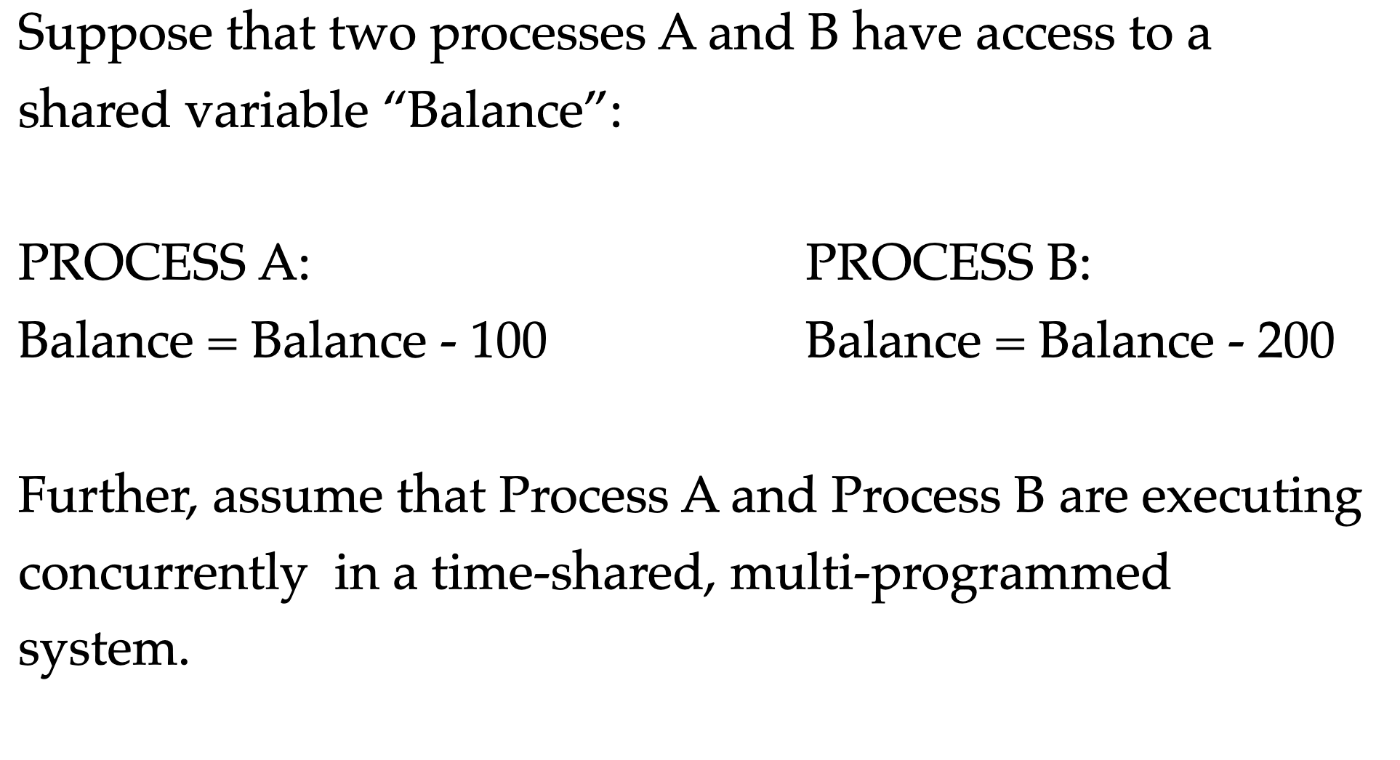
Race condition
threads
Thread A:
Thread B:
Thread
Thread

Slide 37
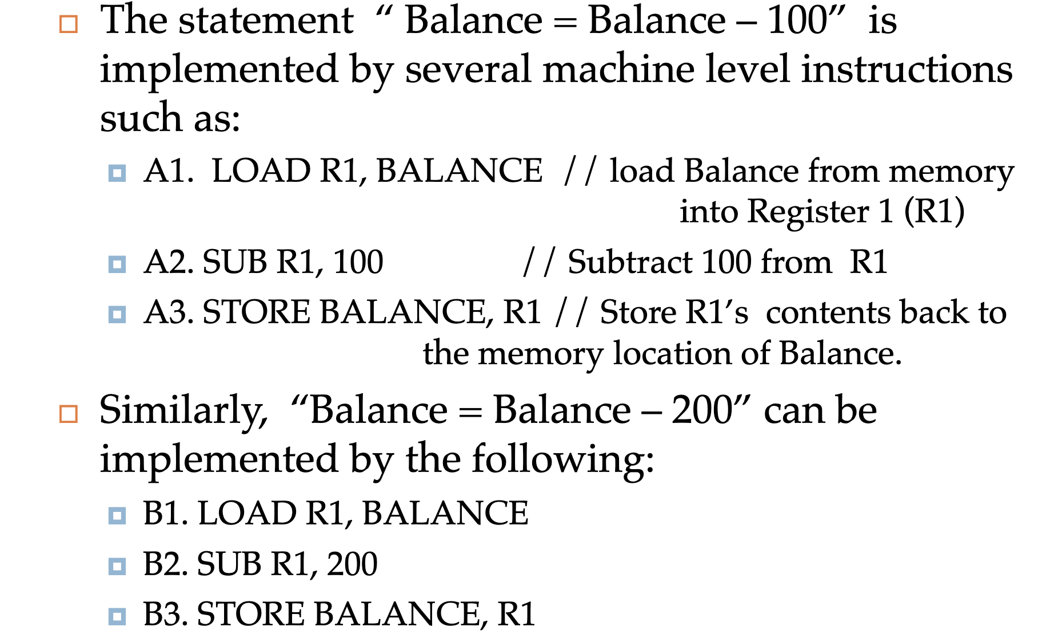
Race condition

Slide 38
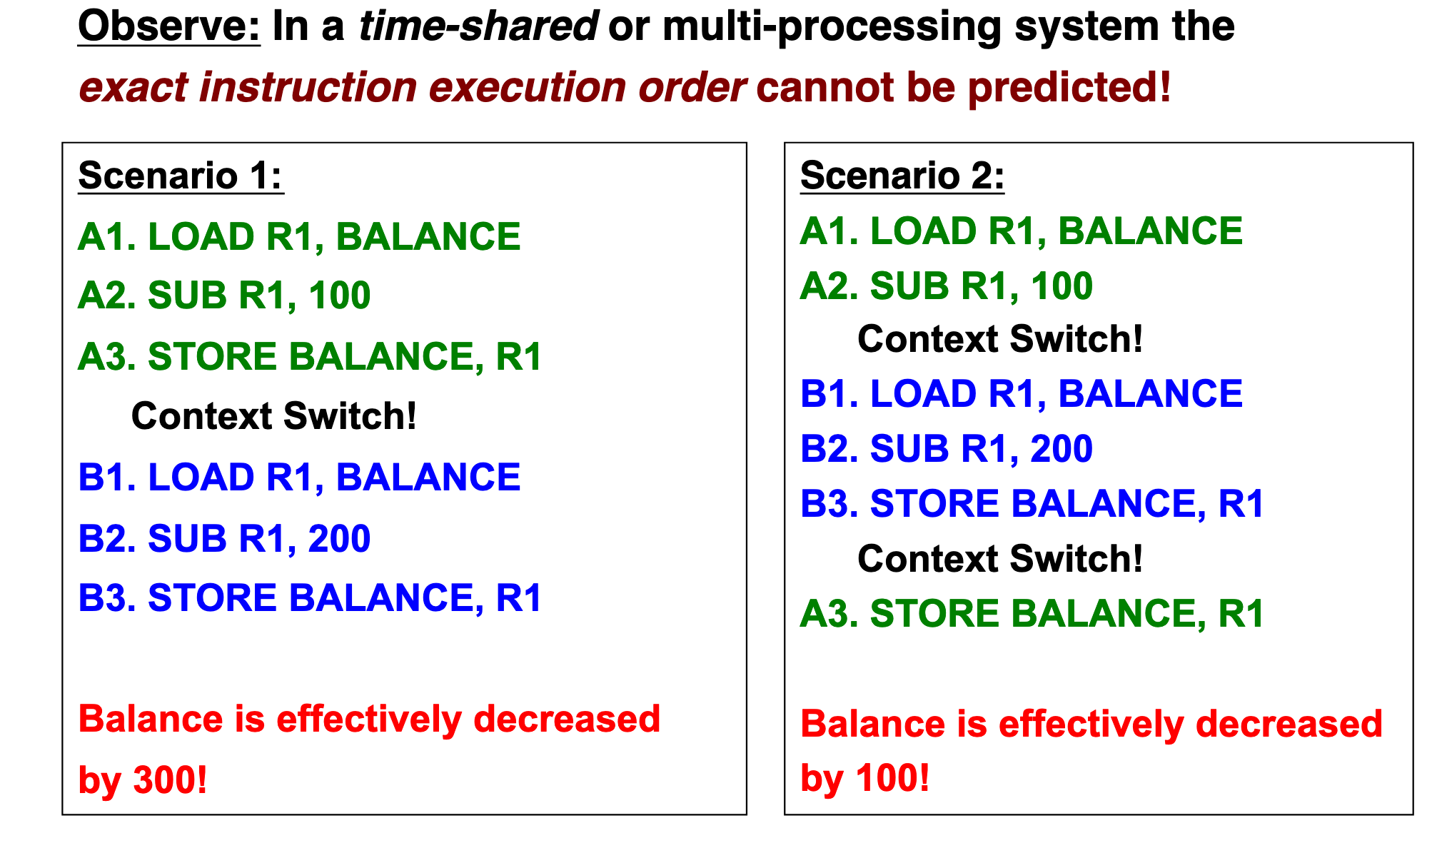
Race condition

Slide 39
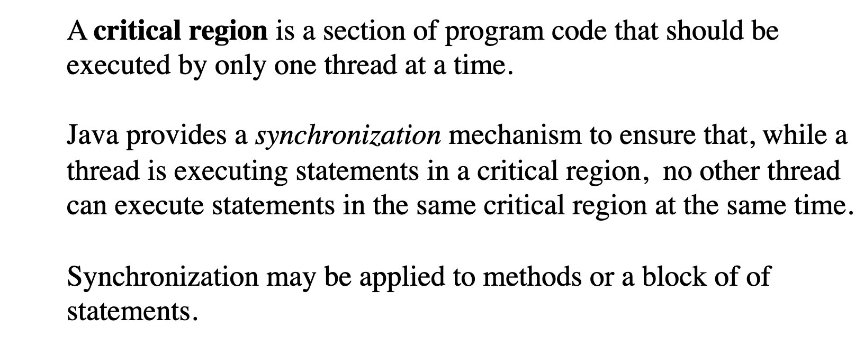
Critical region (section)

Slide 40
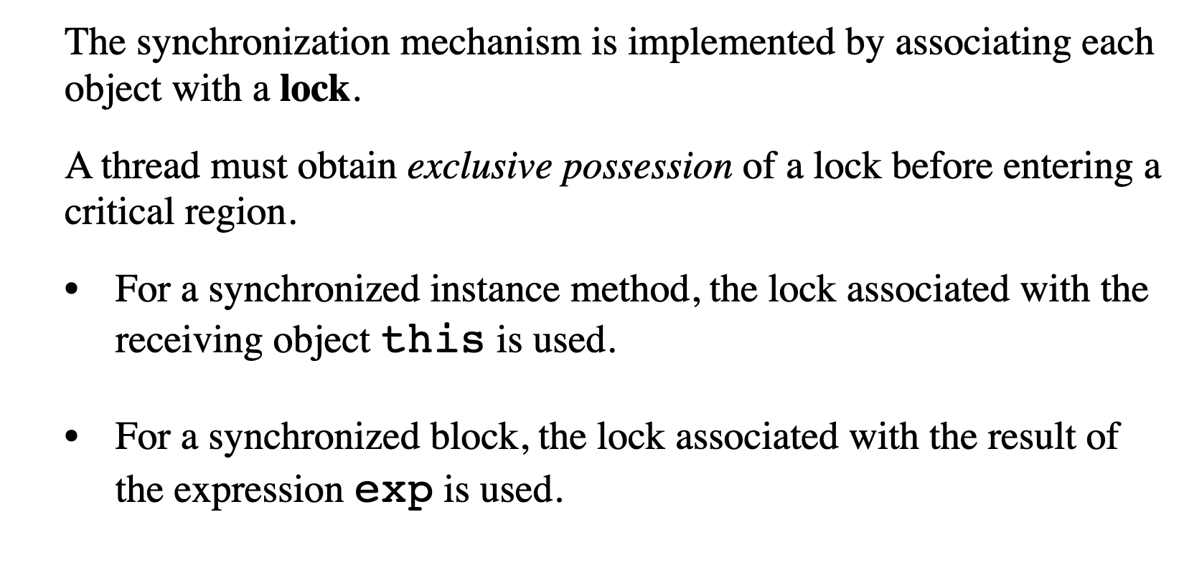
Lock (monitor)

Slide 41
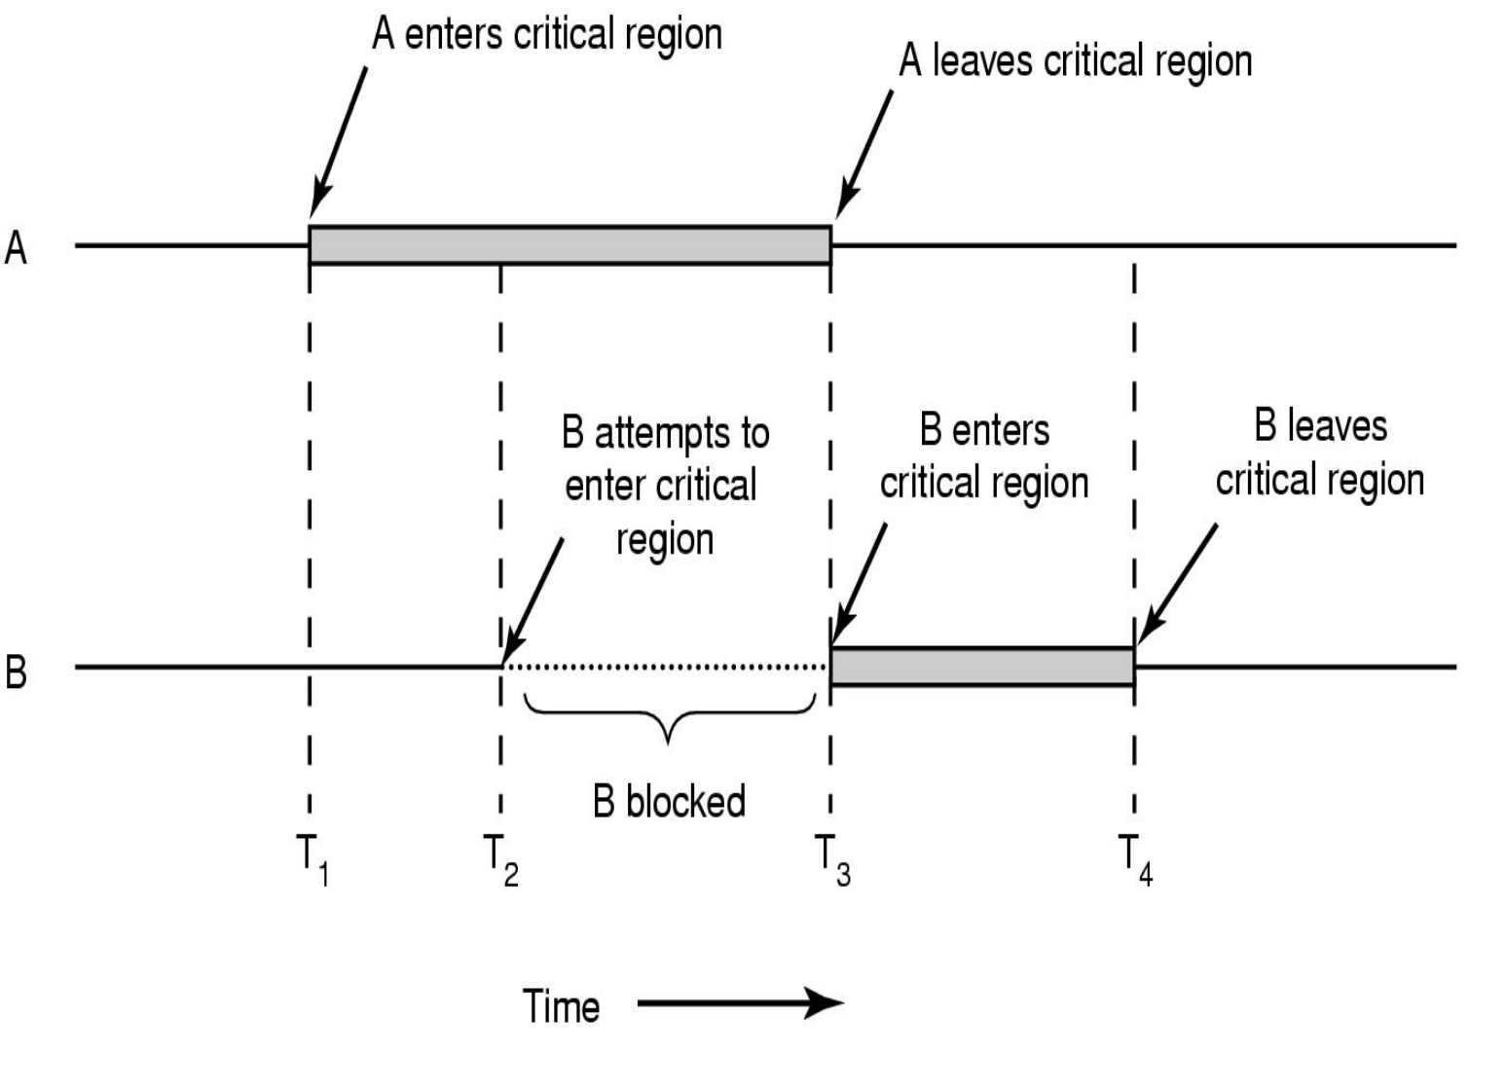
Lock (monitor)

Slide 42
Example 4

Slide 43
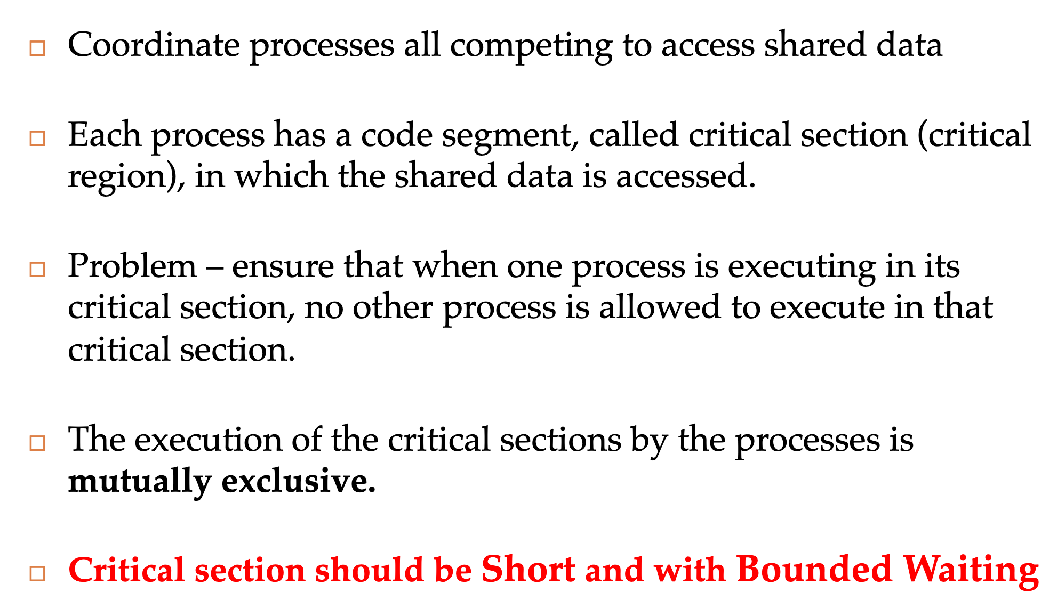
Synchronization

Slide 44
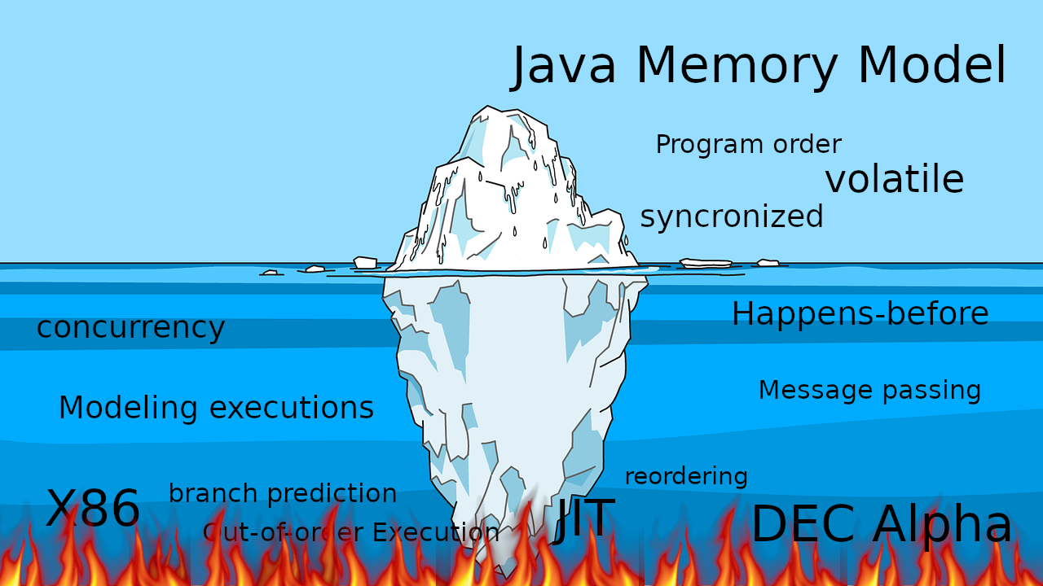
JMM

Slide 45
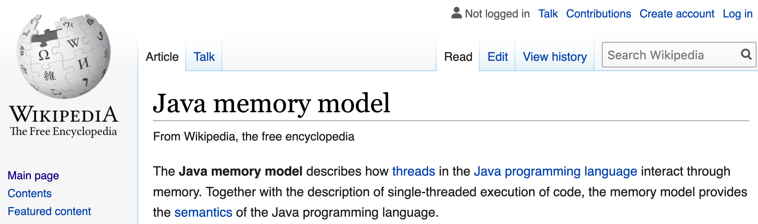
JMM

Slide 46
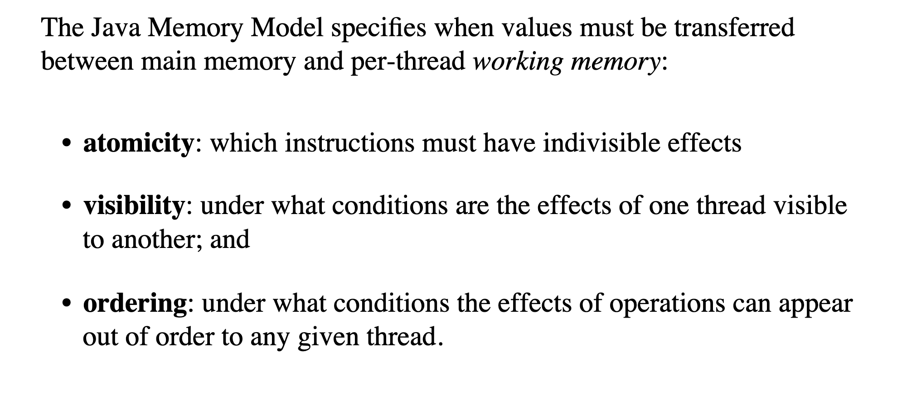
Model properties

Slide 47
CPU

Slide 48
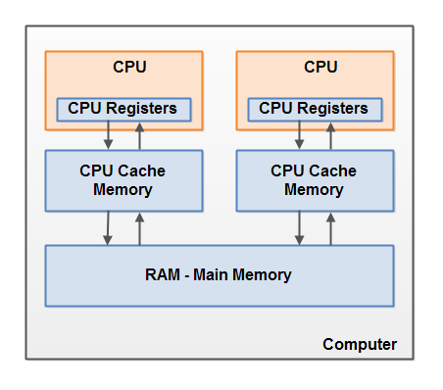
CPU

Slide 49
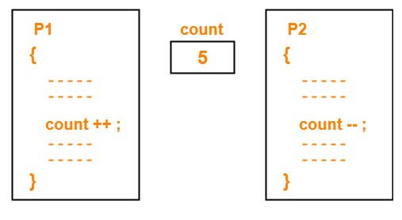
Atomicity

Slide 50
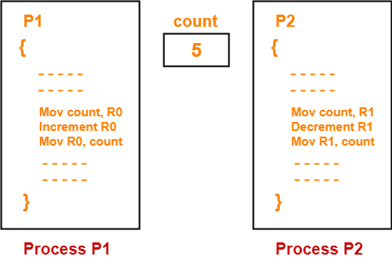
Atomicity

Slide 51
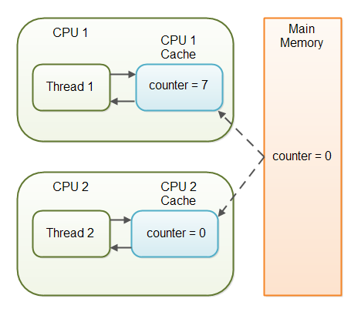
Visibility

Slide 52
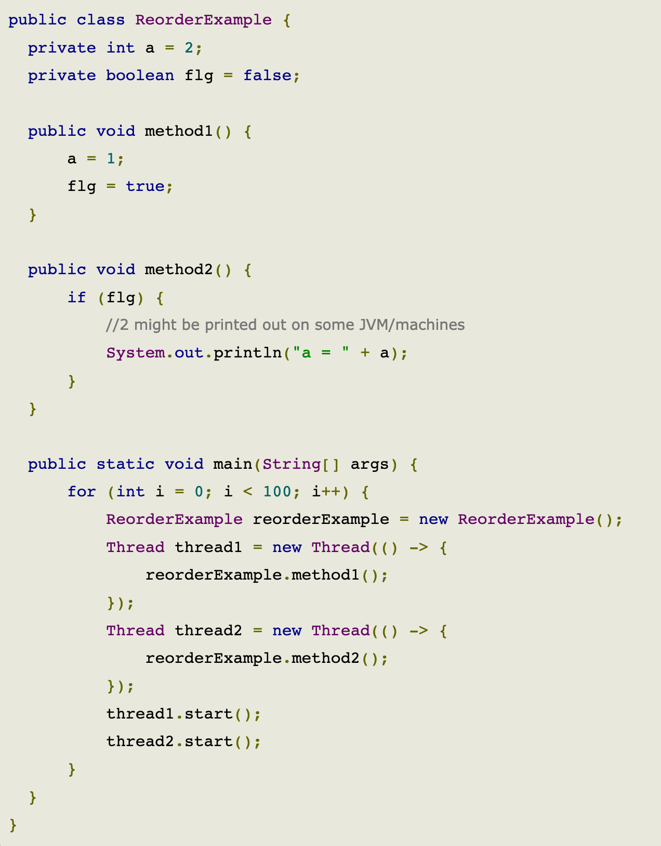
Reordering

Slide 53
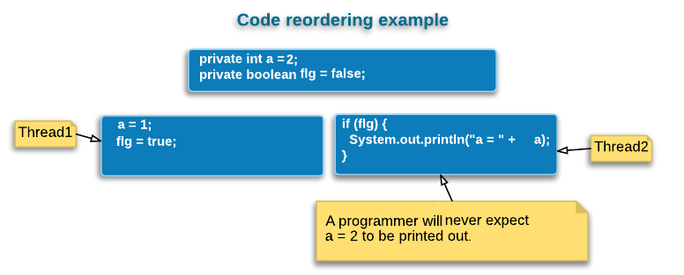
Reordering

Slide 54
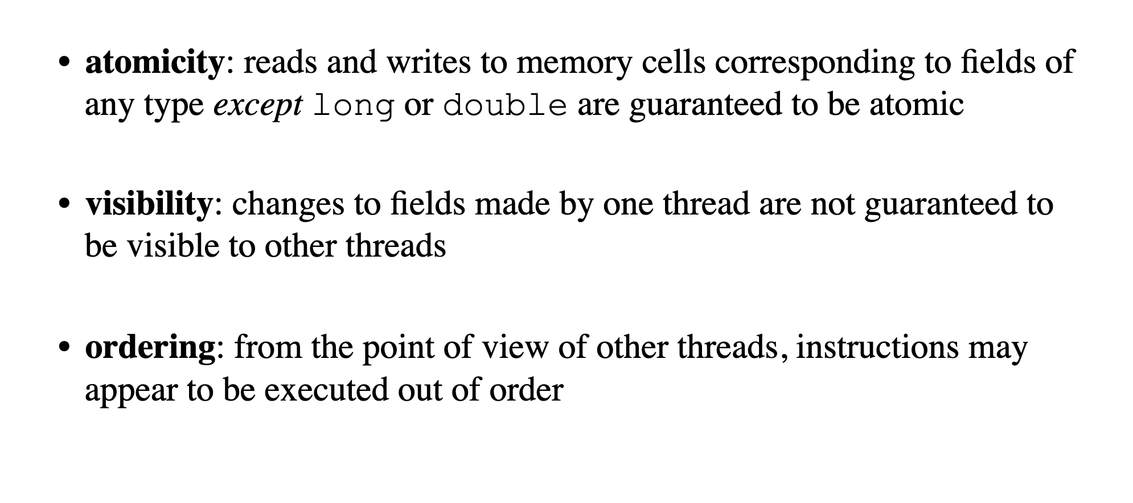
Model properties

Slide 55
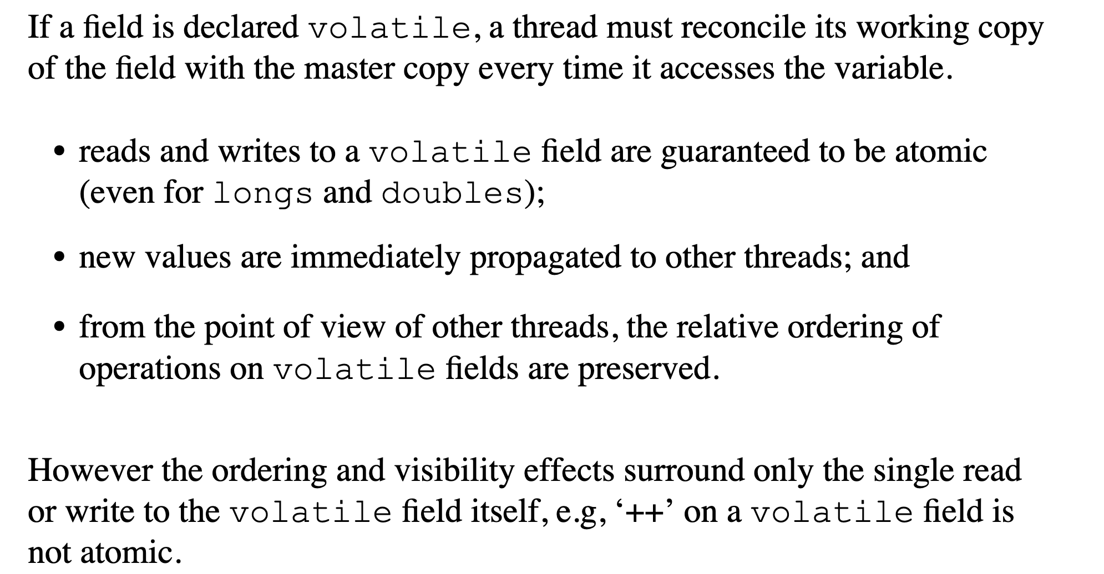
Volatile

Slide 56
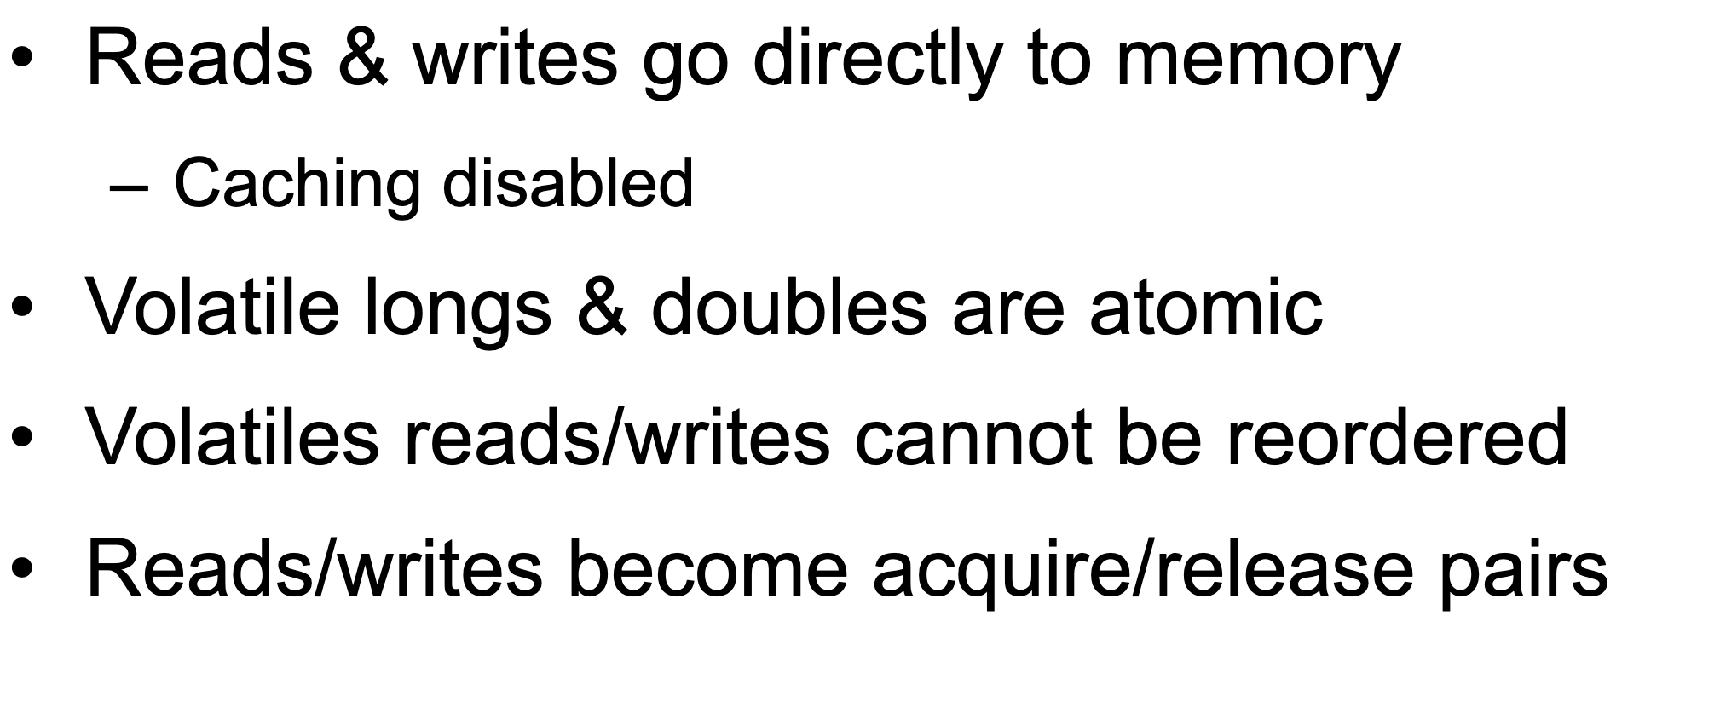
Volatile

Slide 57
Happens before
Happens-before relationship is a guarantee that action performed by one thread is visible to another action in different thread.
Transitivity: If A happens-before B, and B happens-before C, then A happens-before C.

Slide 58
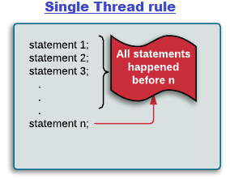
Single thread rule
Single thread rule: Each action in a single thread happens-before every action in that thread that comes later in the program order.

Slide 59

Monitor rule
Monitor lock rule: An unlock on a monitor lock (exiting synchronized method/block) happens-before every subsequent acquiring on the same monitor lock.

Slide 60

Volatile rule
Volatile variable rule: A write to a volatile field happens-before every subsequent read of that same field. Writes and reads of volatile fields have similar memory consistency effects as entering and exiting monitors (synchronized block around reads and writes), but without actually acquiring monitors/locks.

Slide 61

Thread start rule
Thread start rule: A call to Thread.start() on a thread happens-before every action in the started thread. Say thread A spawns a new thread B by calling thread A.start(). All actions performed in thread B's run method will see thread A's calling thread A.start() method and before that (only in thread A) happened before them.

Slide 62

Thread join rule
Thread join rule: All actions in a thread happen-before any other thread successfully returns from a join on that thread. Say thread A spawns a new thread B by calling threadA.start() then calls threadA.join(). Thread A will wait at join() call until thread B's run method finishes. After join method returns, all subsequent actions in thread A will see all actions performed in thread B's run method happened before them.

Slide 63

Thread safety
thread safety = atomicity + visibility

Slide 64
Example 5,6,7

Slide 65

Thread signaling

Slide 66

Wait

Slide 67

Notify

Slide 68

Thread signaling issue

Slide 69
Example 8

Slide 70

Starvation

Slide 71

Dormancy (Livelock)

Slide 72

Deadlock

Slide 73

Deadlock

Slide 74

Deadlock

Slide 75

Deadlock

Slide 76
Example 9

Slide 77


Daemons

Slide 78
Conclusion

Slide 79

Sequential vs concurrent

Slide 80
Performance

Slide 81

Amdahl's law

Slide 82

Resource utilization

Slide 83

Resource utilization

Slide 84


Resource utilization

Slide 85

Latency

Slide 86

Modern way

Slide 87






Concurrent Dijkstra algorithm

Slide 88
Multi thread migration

Slide 89
Single thread migration
7h21 min 1.7 r/s

Slide 90
Multi thread migration

Slide 91
Multi thread migration
7h21 min 1.7 r/s
28 min 23 r/s

Slide 92

The show begins

Slide 93

#1 Difficult to debug

Slide 94

#2 Race condition

Slide 95

#3 Dead locks

Slide 96
Concurrency mad stuff
“But I don’t want to go among mad people," Alice remarked. - "Oh, you can’t help that," said the Cat: "we’re all mad here. I’m mad. You’re mad." - "How do you know I’m mad?" said Alice. - "You must be," said the Cat, "or you wouldn’t have come here.”
Alice's Adventures in
Wonderland by Lewis Carroll

Slide 97


Dev practices
On Java 8 by Bruce Eckel

Slide 98


Dev practices
On Java 8 by Bruce Eckel

Slide 99

#4 Non deterministic behavior

Slide 100

#4 Non deterministic behavior

Slide 101

#4 Non deterministic behavior

Slide 102

#4 Non deterministic behavior

Slide 103
Are you still here?
Twas brillig, and the slithy toves Did gyre and gimble in the wabe: All mimsy were the borogoves, And the mome raths outgrabe
Jabberwocky by Lewis Carroll

Slide 104

Let’s continue?

Slide 105

#5 Performance degradation

Slide 106

#5 Performance degradation

Slide 107

#6 OS limitation

Slide 108

Stop it? Hell no…

Slide 109

#7 Hardware unpredictable optimizations

Slide 110

Concurrency in real world
On Java 8 by Bruce Eckel

Slide 111
Conclusion
Concurrency is powerful practice, you can achieve a lot using it
Don’t use concurrency if you can avoid it
Use best practices by experts
Use frameworks with big professional community
Minimize synchronization and data sharing
Perform load and stress testing
Use as much as possible existed solutions
Don’t forget about mad world and wonders

Slide 112
Resources
Java concurrency in practice (Brian Goetz )
On Java 8 (Bruce Eckel)
The Art of Multiprocessor Programming (Maurice Herlihy , Nir Shavit )

Slide 113

THANK YOU!
artyom-karnov@yandex.ru, Saint-Petersburg, 2019

